Slide 1
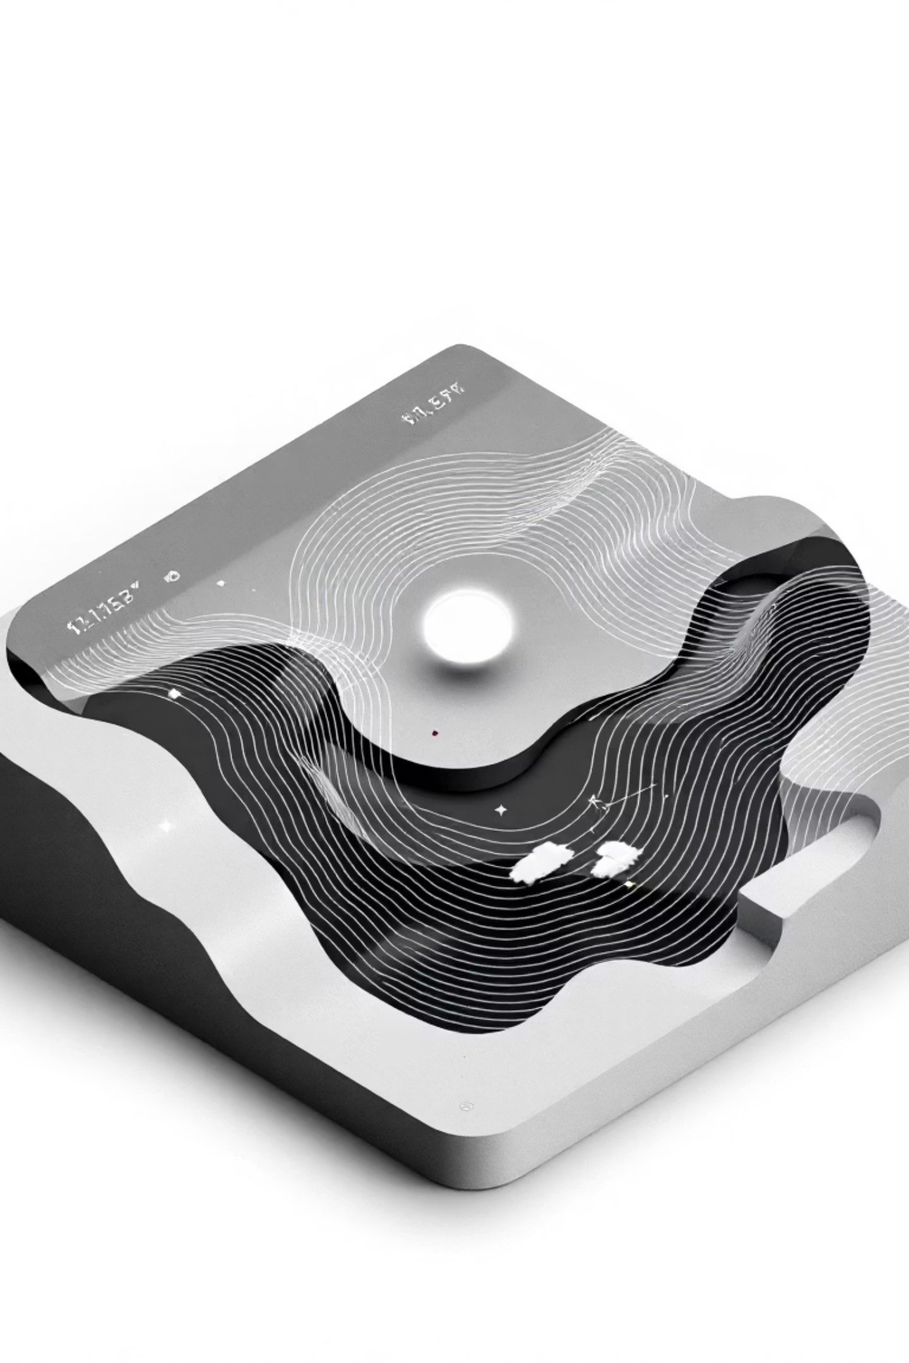
Weather Vibes: NASA Climate Data Made Human
Transforming complex NASA climate science into intuitive "vibe-based" weather discovery for hackathon judges, developers, and UX designers. Created by Team Vibe Finders for the NASA Space Apps Challenge.

Slide 2
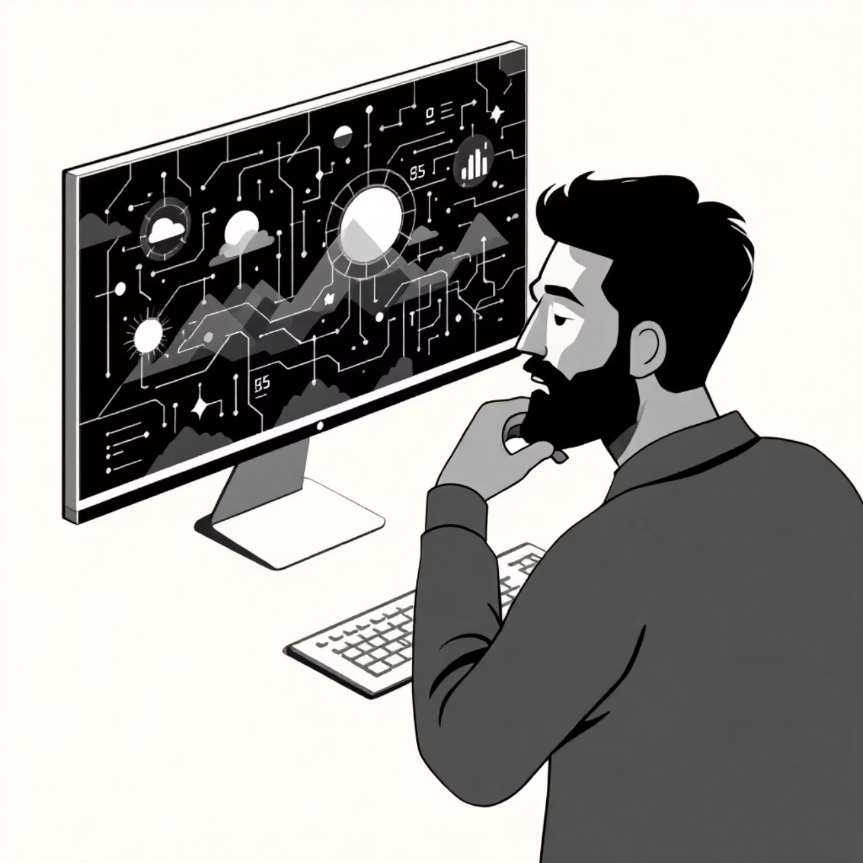
The Problem We're Solving
Traditional weather applications overwhelm users with complex meteorological data, forcing them to interpret charts, graphs, and technical parameters. This creates a significant barrier between human intentions ("I want perfect stargazing conditions") and actionable weather insights.
NASA's POWER API provides decades of rich climate data, yet this treasure trove remains largely inaccessible to everyday users who simply want to know when and where to pursue their favourite activities.
Weather Vibes bridges this gap by translating human desires into data-driven recommendations, making Earth science accessible and actionable for everyone from travel bloggers to farmers.

Slide 3

Our Vision: Vibe-Based Weather Discovery
Human-Centred Design
NASA Data Integration
Users express what they want to do, not which weather parameters they need. "Perfect Stargazing Night" instead of "Low cloud cover, minimal humidity".
Decades of historical climate information processed through our "Vibe Engine" to provide concrete, actionable recommendations backed by science.
Intelligent Recommendations
Advanced algorithms translate subjective experiences into objective data analysis, providing both temporal and geographical guidance.

Slide 4
Core Features: Where, When & Specialised Advisors
01
02
03
The "Where" Feature: Vibe Hotspot Finder
The "When" Feature: Vibe Calendar
Specialised Aura Advisors
Advanced feature providing pre-configured, high-value recommendations including Crop & Farming Advisor for agricultural planning, Climate Mood Predictor for wellness suggestions, and AI Fashion Stylist for weather-appropriate outfit recommendations.
Generates interactive heatmaps answering "Given my vibe and a time, where should I go?" Perfect for travel bloggers seeking misty mountain locations for monsoon photography, or event organisers finding the driest locations for outdoor festivals within a 200km radius.
Creates monthly "vibe score" calendars answering "Given my vibe and location, when should I go?" Ideal for hobbyist astronomers determining optimal stargazing months from their rooftop, or families planning wildlife viewing trips to national parks.

Slide 5

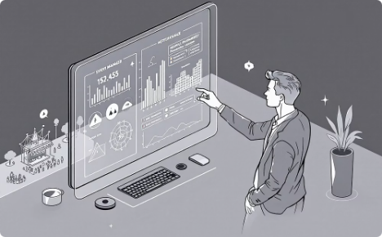
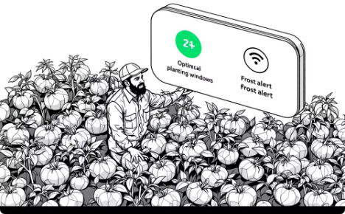
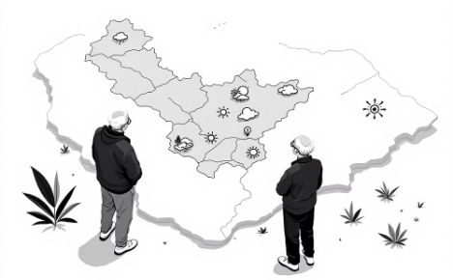
Target Personas: Real Users, Real Needs
The Travel Blogger (Anjali)
The Event Organiser (David)
The Farmer (Mr. Gowda)
The Retired Couple (The Sharmas)
Agricultural professional near Chikkaballapur needing optimal planting windows and frost alerts for tomato crops. Requires precise timing based on historical climate patterns for maximum yield.
A Bangalore-based content creator needing picturesque, misty mountain locations in South India for Instagram content during July monsoons. Requires specific atmospheric conditions for compelling visual storytelling.
Event manager planning 3-day music festivals, requiring locations within 200km of Bangalore with historically lowest rainfall probability in February. Risk mitigation through data-driven venue selection.
Seeking quiet Western Ghats towns for winter residence (Nov-Jan) with mild climate (18-25°C). Long-term planning based on consistent historical weather patterns.

Slide 6

The Vibe Engine: Translating Feelings into Data
Our core innovation lies in the Vibe Engine—a sophisticated algorithm collection that translates human desires into quantifiable meteorological parameters. The system operates through a central Vibe Dictionary (JSON configuration file) that maps subjective experiences to objective NASA data parameters.
Each "vibe" contains weighted parameters with specific scoring functions:
low_is_better: For parameters like cloud cover in stargazing
high_is_better: For solar radiation in beach activities
optimal_range: For temperature preferences using trapezoidal functions
The engine processes historical NASA POWER data through normalisation algorithms, applying weighted scores to generate actionable 0-100 recommendations. Advanced advisors utilise custom logic functions for specialised recommendations beyond simple scoring.

Slide 7




Technical Architecture: Scalable & Sophisticated
Frontend Layer
Next.js with React providing responsive user interface. Mapbox GL JS integration for interactive heatmaps. Chakra UI components ensure consistent design language. Zustand manages application state efficiently.
Backend Engine
FastAPI with Python powering the Vibe Engine. Geospatial processing through rasterio and geopandas libraries. RESTful API design with Pydantic models ensuring type safety and validation.
Data Infrastructure
GeoTIFF files on AWS S3 storing pre-processed NASA POWER data. Automated cron jobs maintain current datasets. Efficient spatial indexing enables rapid query responses across geographical regions.

Slide 8
Team Roles & Development Strategy
Kiran - Data Lead & Advisors
Vivek - Backend Lead & "Where"
Owns complete data layer including NASA POWER API integration and GeoTIFF processing. Implements full-stack "Specialised Aura Advisors" feature with backend logic and frontend recommendation UI components.
Architects FastAPI server foundation, defines API contracts, and manages CORS configuration. Implements comprehensive "Where" feature with heatmap generation logic and frontend integration support.
1
2
3
Bhawesh - Frontend Lead & "When"
Manages Next.js application shell, UI/UX design, and Mapbox integration. Develops complete "When" feature including calendar API endpoints and interactive frontend visualisation components.
Our parallel development approach ensures efficient resource utilisation whilst maintaining clear ownership boundaries. Each team member combines infrastructure responsibility with full-stack feature development, promoting both specialisation and cross-functional collaboration.

Slide 9



Development Phases: From Foundation to Polish
Phase 1: Parallel Foundation
Simultaneous development of core infrastructure. Bhawesh establishes Next.js shell and Mapbox integration, Kiran develops data processing pipeline, Vivek creates FastAPI architecture with mock endpoints.
Phase 2: Feature Integration
Full-stack feature implementation with sample GeoTIFF data. Each developer owns complete feature delivery whilst collaborating through shared infrastructure components.
Phase 3: Final Polish
Complete data processing, UI/UX refinement, and comprehensive testing. Integration of all components into polished demonstration-ready application.
This structured approach enables efficient parallel development whilst maintaining integration checkpoints. Clear ownership boundaries prevent conflicts, whilst shared infrastructure ensures consistency across features.

Slide 10

Impact & Innovation: Making Earth Science Accessible
40+
3
∞
NASA Parameters
Core Features
Possibilities
Decades of climate data translated into human-friendly recommendations
Where, When, and Specialised Advisors covering diverse user needs
Extensible vibe dictionary enabling unlimited activity-weather combinations
Weather Vibes represents a paradigm shift in how humans interact with climate data. By transforming NASA's comprehensive Earth science information into intuitive, activity-focused recommendations, we democratise access to decades of meteorological knowledge.
Our innovation lies not merely in technical implementation, but in the fundamental reimagining of weather applications as human-centred tools. Rather than expecting users to become meteorologists, we've made meteorology serve human intentions—creating a bridge between Earth science and everyday life that empowers informed decision-making for everyone from farmers to photographers.

